Slide 1
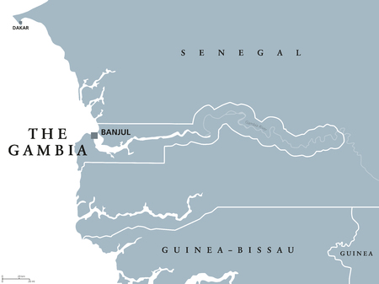
Gambia Malaria Bayesian Modeling
By Elie Nehme, Jose Angel Torres, Austin Wolin
STA 4345 - B001 Applied Bayesian Statistics
University of Central Florida - Summer 2024

Slide 2
Importance of Modeling Malaria in Gambia
Modeling malaria in Gambia is vital in providing information for:
Public health planning
Resource allocation
Intervention efficacy
Understanding transmission dynamics
Economic impact analysis
Guiding research
Supporting global health initiatives
Tailoring local control measures.

Slide 3
Objectives
Our purpose in presenting this dataset is ultimately to find the best model for predicting malaria prevalence in Gambia.
This is done by comparing the performance of three Bayesian logistic regression models: Bayesian Ridge, Bayesian Lasso, and Bayesian SSVS.
We can see these differences operationally using various metrics (DIC, WAIC, Bayes Factor, and 5-fold cross-validation AUC) to find the most powerful model for feature selection.

Slide 4
Malaria
Malaria is a Protozoa infection of red blood cells and liver
Occurs in tropics, subtropics
Very rare in US, Europe
Africa is most effected continent
Transmitted by mosquito bite (female Anopheles)
Caused by Plasmodium species.
Several species with distinct features:
P. vivax/P. ovale – Most abundant globally
P. falciparum – Most virulent; mostly found in the tropics, causes most malaria mortality
P. malariae

Slide 5
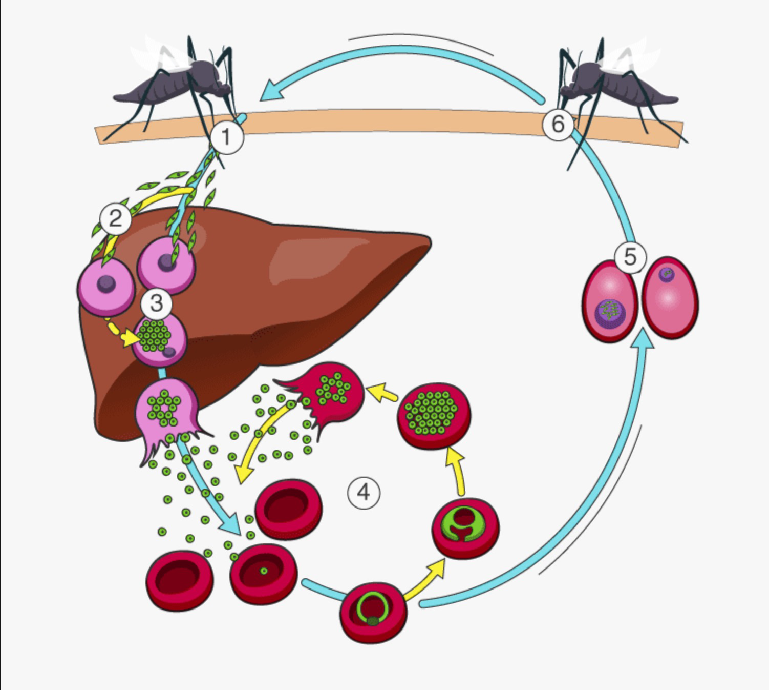
Malaria - Life Cycle
1. Transmission to human
injects sporozites (infective form)
2. Sporozites enter liver and infect hepatocytes (Incubation Period)
3. Liver cells rupture and merozites release
Leads to RBCs infection
4. intra-erythrocytic cycle
Plasmodium Matures and RBC lysis
Releases Merozites again
5. Sexual Cycle
Some Merozites develop into male and female gametocytes
6. Transmission to mosquito from infected person

Slide 6
MalARIA - SYmptoms
Common symptoms
Paroxysms of fever
Shivering and chills followed by high fever
Fever recurs at regular intervals (48hrs, 72hrs)
Variable by species of Plasmodium
Anemia (RBC infection)
Severity varies by species of Plasmodium
Hemolytic: sometimes jaundice
Splenomegaly
Also nonspecific symptoms:
Sweating, fatigue, malaise, arthralgias, headache
Sometimes cough, vomiting, diarrhea
Rare symptoms
Altered consciousness (especially when febrile)
Seizures
“Blackwater fever”
Renal failure with hemoglobinuria
Shock
Severe symptoms usually due to P. falciparum

Slide 7
P. falciparum
Induces sticky “knobs” on RBC surfaces
Knobs composed of parasite proteins
P. falciparum erythrocyte membrane protein 1 (PfEMP1)
Knobs bind receptors on endothelial cells
Result is occluded capillaries
Cerebral malaria (occluded vessels in brain)
Altered consciousness, delirium, coma
Renal failure (“blackwater fever”)

Slide 8
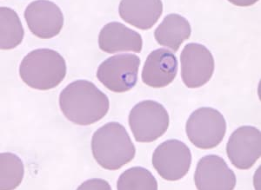
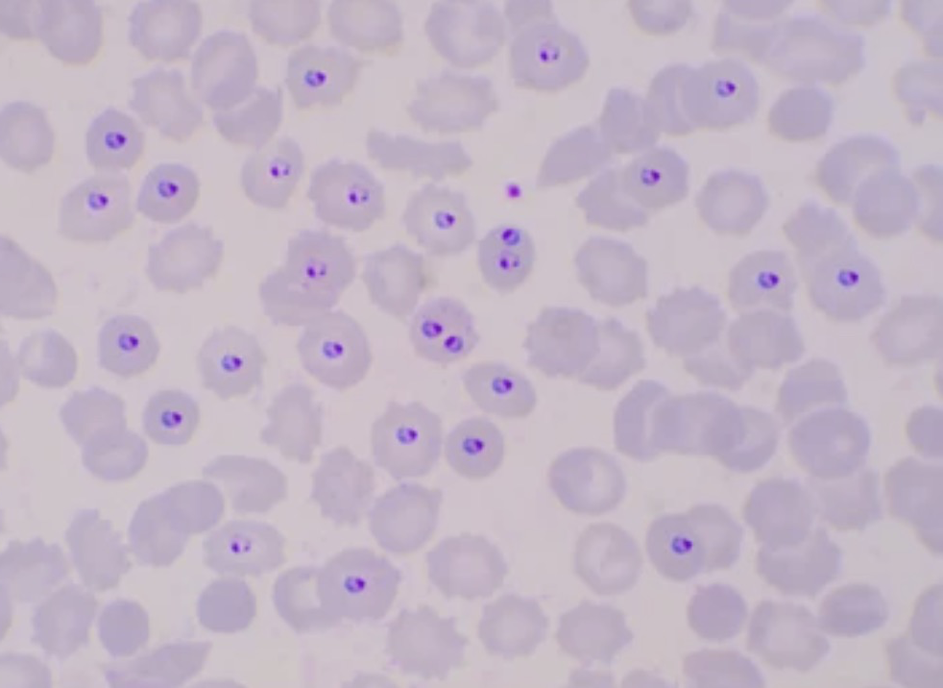
Malaria Diagnosis
Blood smear (Giemsa or Wright stains)

Slide 9
Malaria - Treatment
Chloroquine
Weak base
Accumulates in food vacuoles (acidic) of RBC trophozoites
Blocks plasmodium heme polymerase
Heme portion of Hgb toxic to parasite
Plasmodium converts this to nontoxic form
Lots of chloroquine resistance
Used mainly in limited areas (“chloroquine sensitive”)
Not used for severe infections
Only kills erythrocytic forms (not liver forms)
Retinopathy associated with long-term use
For Severe infections
Artesunate (IV)
Quinidine (IV)
Other drugs
Mefloquine (commonly used in chloroquine resistant areas)
Primaquine (liver phase only; not active against RBC phase)
Atovaquone

Slide 10
Immunity to Malaria
People residing in malaria-endemic regions acquire immunity through natural exposure (acquired immunity).
This does not necessarily prevent infection, but provides protection against the severe effects of malaria.
Acquired immunity can wane and disappear if the individual is not exposed to the parasite for an extended period of time
Antibody-mediated acquired immunity can be transferred from mother to fetus across the placenta, providing newborns with some degree of protection.
This wanes within 6-9 months, leaving the child vulnerable to infection.

Slide 11
Malaria – Interesting Facts
Protective Factors
Concern with G6PD Deficiency
Duffy antigen
Necessary for P. vivax infection
Absence of Duffy → protective
Sickle cell
May have evolved as protection from malaria
Children with HbS have lower risk of falciparum infection
Thalassemia
Reduced parasite multiplication in P. falciparum infection
G6PD Deficiency
X-linked genetic disorder
Hemolytic anemia triggered by various stressors
Infections
Fava beans
Drugs
Many malaria drugs trigger anemia in G6PD
Quinidine
Primaquine
Often test for G6PD deficiency prior to treatment:
Primaquine for P. vivax/ovale liver phase
IV Quinidine for life threatening P. Falciparum

Slide 12
gambia dataset
gambia is a data frame with 2035 observations and the following 8 variables:
x: x coordinate of the village (UTM).
y: y coordinate of the village (UTM).
pos: presence (1) or absence (0) of malaria in a blood sample taken from the child.
age: age of the child in days.
netuse: indicator variable denoting whether (1) or not (0) the child regularly sleeps under a bed-net.
treated: indicator variable denoting whether (1) or not (0) the bed-net is treated (coded 0 if netuse=0).
green: satellite-derived measure of the greenness of vegetation in the immediate vicinity of the village.
phc: indicator variable denoting the presence (1) or absence (0) of a health center in the village.

Slide 13
DATA PREPROCESSING
Response variable:
pos; presence (1) or absence (0) of malaria in a blood sample taken from the child.
Information was subset into Y variable
Predictors:
age, netuse, treated, green, phc
Information was subset into X variable
Data inspected for presence of NA's: 0 found
Coordinates x and y were excluded from overall study
All data scaled to reduce bias and compare all models with accuracy.
Runs and burn were changed to 5,000 and 1,000 respectively.

Slide 14
METHODOLOGY: SSVS
Using the combination of priors and predictors to optimize variable selection, SSVS tries
different combinations of variables to see which gives us the best results. SSVS illustrates where
our predictors are most probable as well as a layout of our uncertainty using inclusion
probabilities and posterior distributions/probabilities
The prior used for this model is the Logit Zellner Prior. A prior known for its ability in assisting relevant variable selection

Slide 15
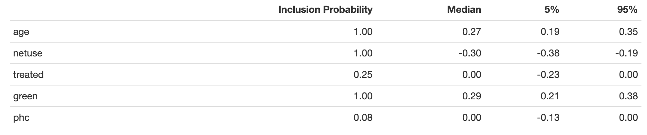
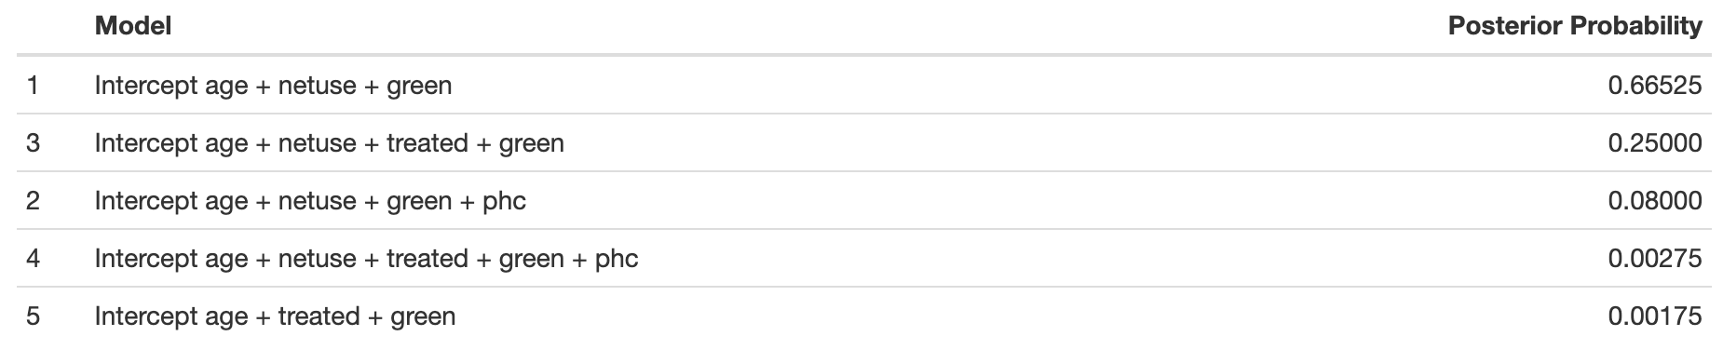
Inclusion & posterior probabilities

Slide 16
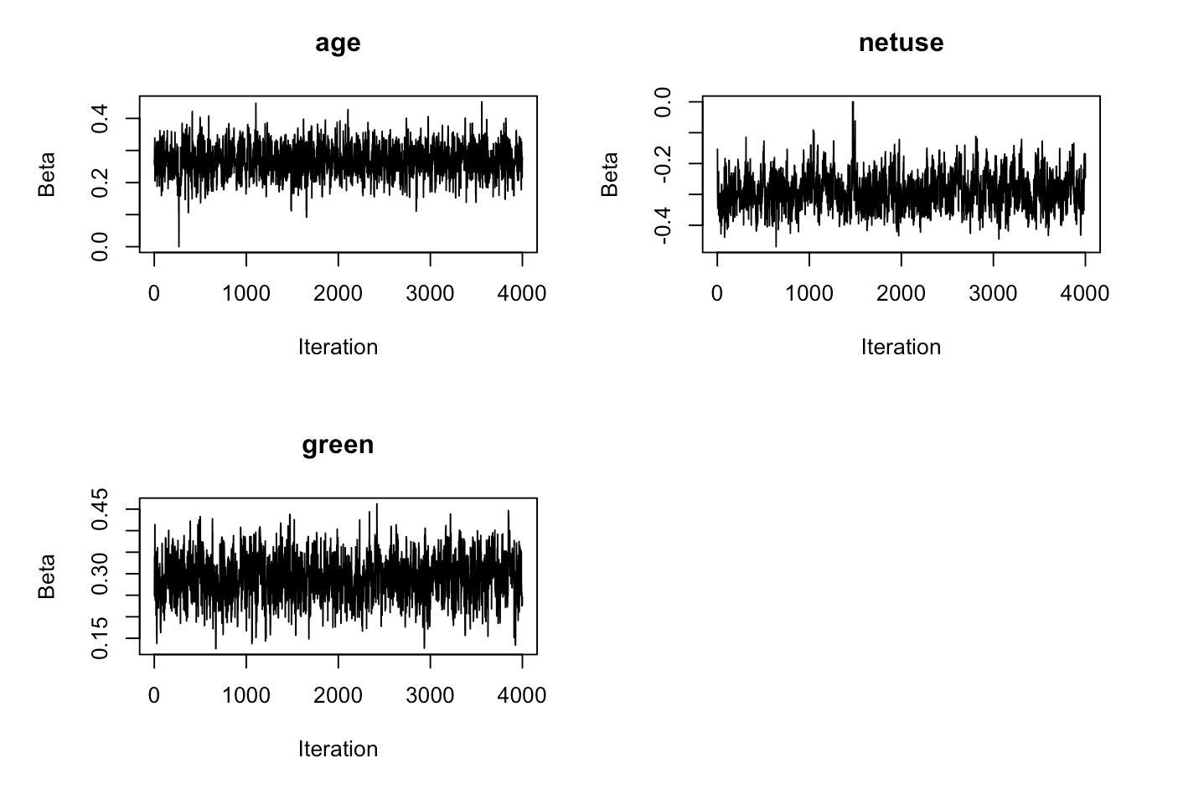
Trace plots for SSVS

Slide 17
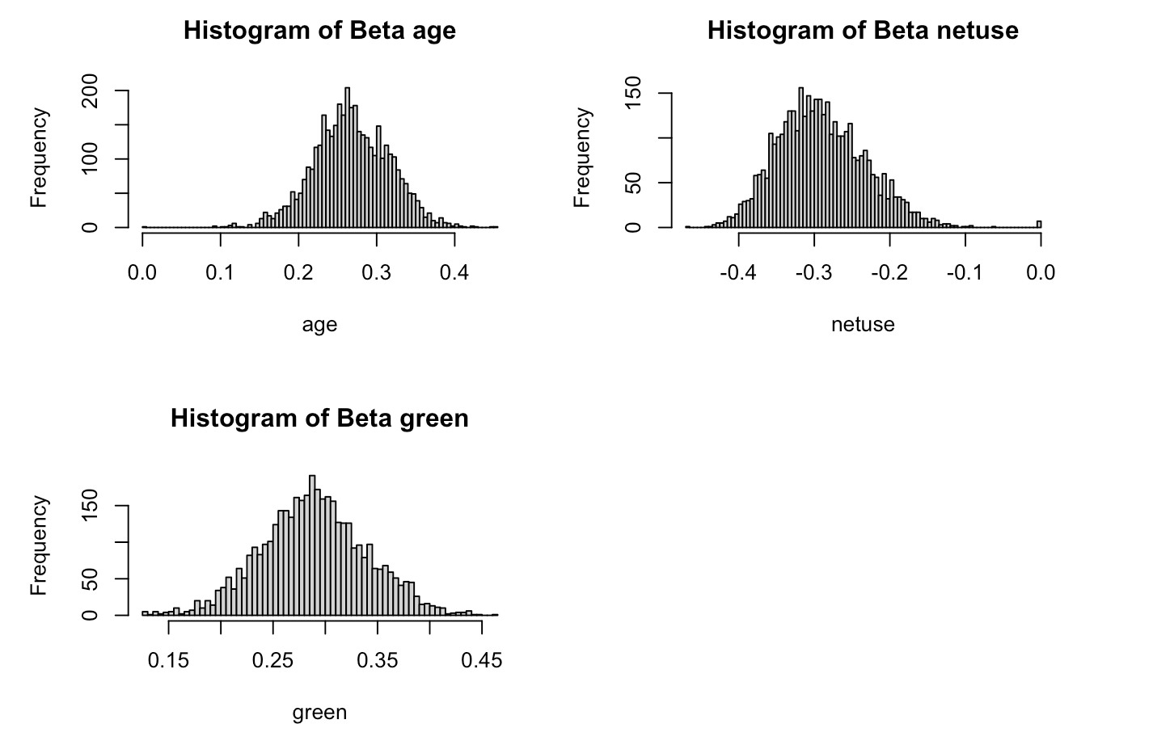
Histograms for significant ssvs predictors
The histograms for our significant betas show clear peaks at approximately 0.26, -0.3 and 0.30 respectively

Slide 18
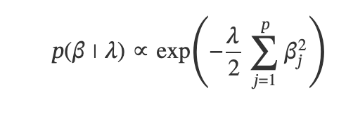
METHODOLOGY: RIDGE
Ridge is a regression technique used specifically for feature selection focusing on the squared
penalty term. It is most known for its lambda value. This value provides a penalty on all beta
coefficients shrinking coefficients of insignificance toward zero but never exactly to it. We can
tune lambda for a greater or lower penalty as we see fit and improve multicollinearity in the
process. Can be easier computationally but not as easy to interpret. It is often referred to as L2
regularization
There are several tuning parameters that can be played with. Ridge places a normal prior on
the beta coefficients with mean 0

Slide 19
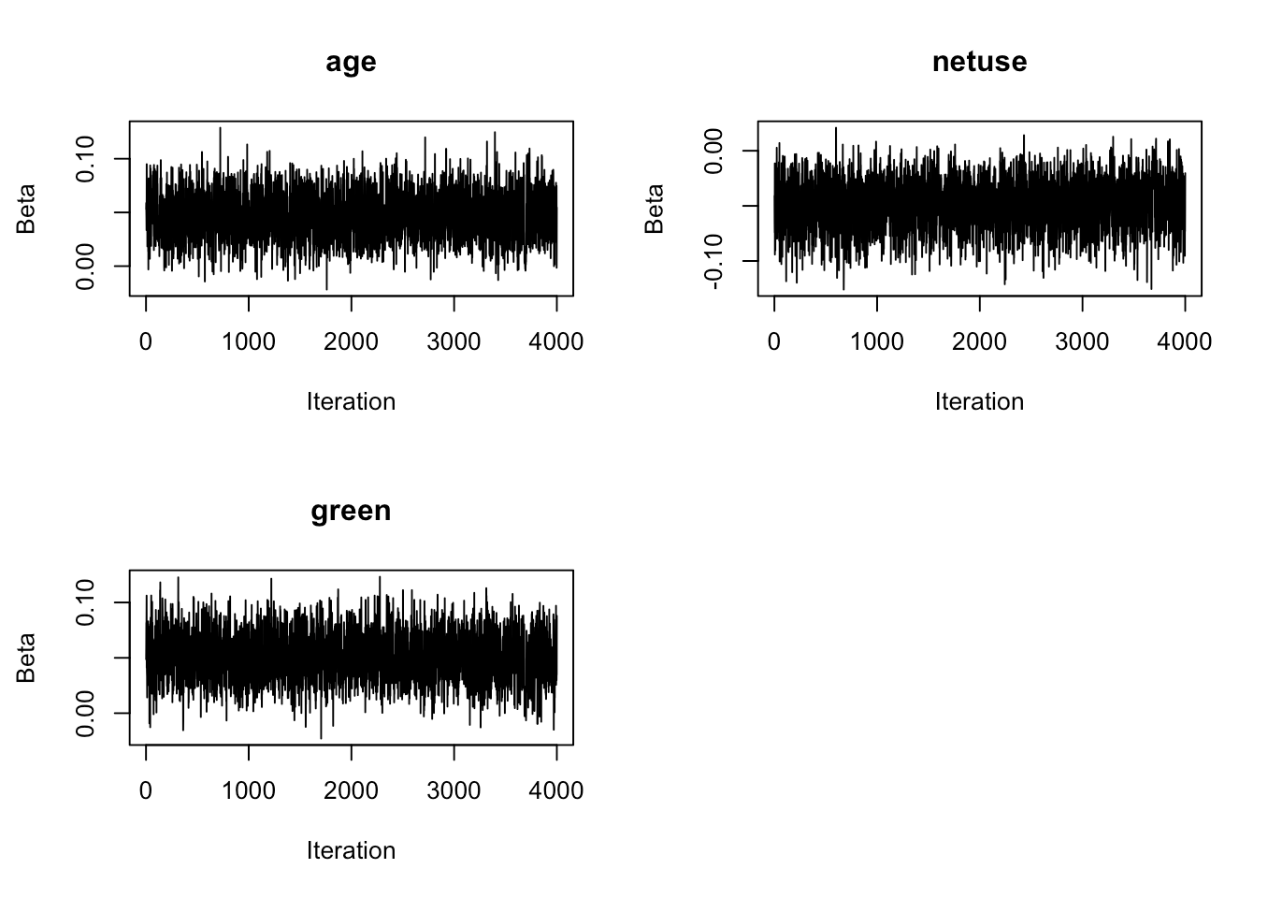
TRACEPLOTS FOR RIDGE

Slide 20
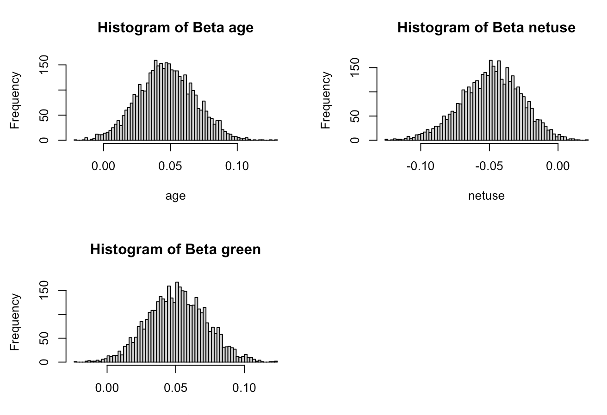
HISTOGRAMS FOR SIGNIFICANT ridge PREDICTORS
For ridge, our histograms peaked at around .04, -.05 and .05 respectively.

Slide 21
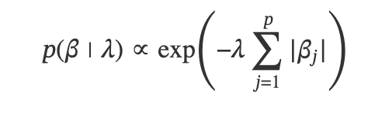
METHODOLOGY: LASSO
Lasso is a regression technique used specifically for feature selection focusing on an absolute
value penalty term . It is most known for its lambda value. This value provides a penalty
on all beta coefficients shrinking coefficients of insignificance to zero. We can tune lambda
for a greater or lower penalty as we see fit and effectively remove variables. Can be easier
computationally but not as easy to interpret. It is often referred to as L1 regularization
Lasso uses a LaPlace prior for regularization

Slide 22
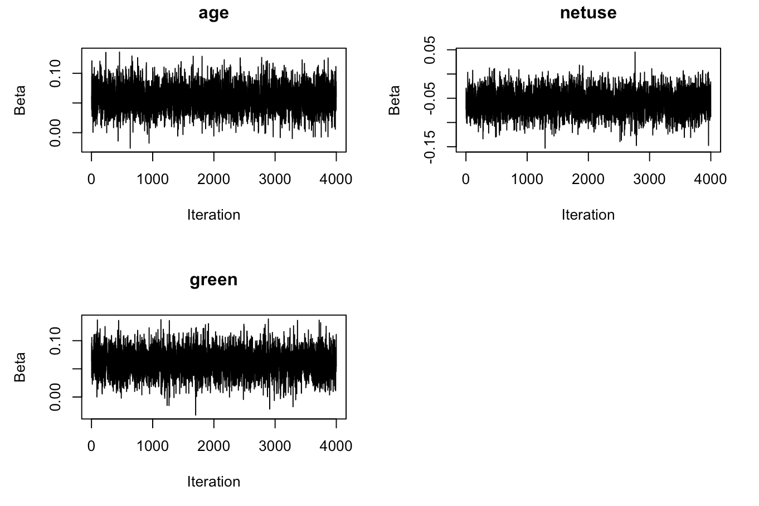
TRACE PLOTS FOR LASSO

Slide 23
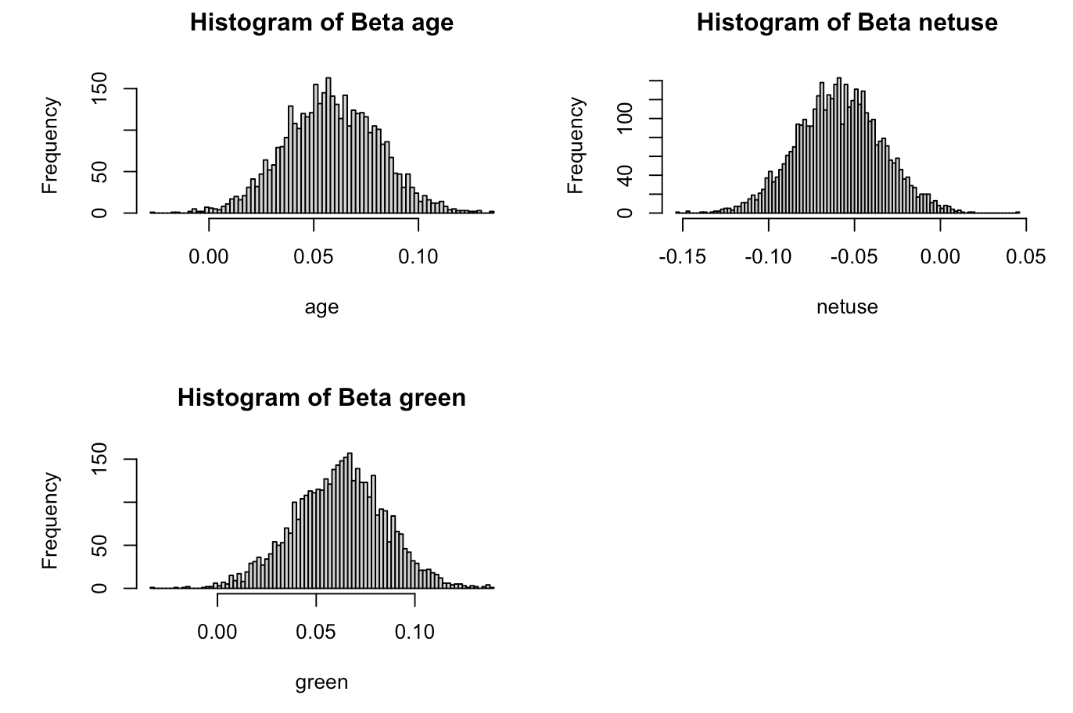
HISTOGRAMS FOR LASSO PREDICTORS
For lasso, our histograms peaked at around .06, -.07 and 07 respectively.

Slide 24
VARIABLE SELECTION
For Ridge and Lasso, significant beta coefficients were determined by evaluating the
set intervals [.05, .95] of all predictor variables and identifying those with the same signs.
For SSVS, we excluded zero coefficients to determine inclusion probabilities and identified
significant predictors, selecting those with inclusion probabilities greater than 50%
Bayesian Lasso, Bayesian Ridge and Bayesian SSVS models all selected variables
age, netuse and green as significant variables for our study.
The Bayesian SSVS model in particular had the largest scale of beta coefficients
when compared with other models. The range of coefficients within the
variables for SSVS indicated a stronger positive impact in age and green in
relation to malaria prevalence and more significant negative impacts on netus as pos
increased.

Slide 25
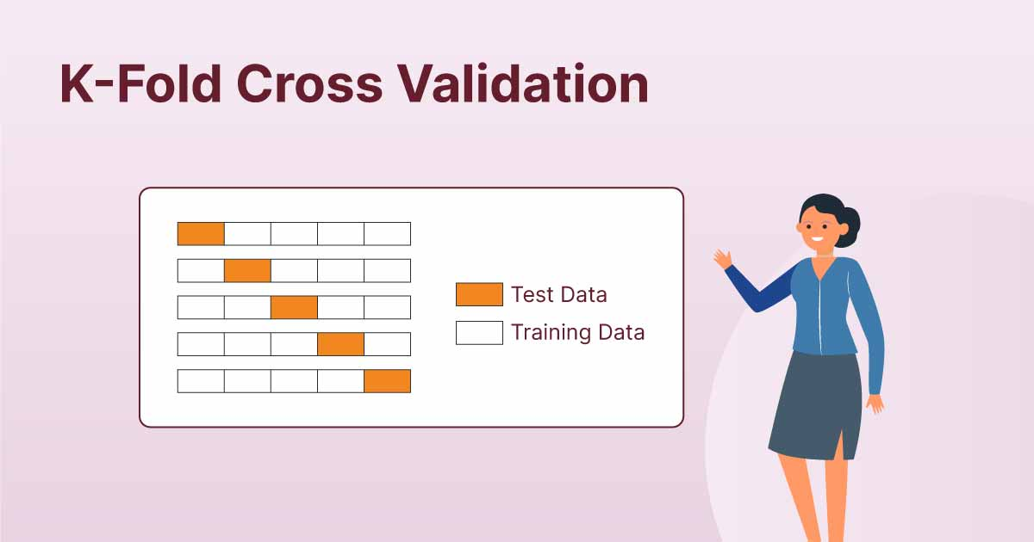
K - fold cross validation: briefly explained
5 fold cross validation is implemented into the calculation of AUC. The dataset is divided into 5 equally sized folds where k = 5 folds are trained and tested. k-1 = 4 folds are used as training while the remaining fold is used as testing. This is done k = 5 times making sure every fold has been trained and tested.
In the context of AUC, when using k fold cv we are more likely to receive reliable estimates ensuring each section of our dataset has been inspected.

Slide 26
INITIAL Model Fit Metrics
DIC (Deviance Information Criterion): Lower values indicate better model fit
Ridge: 12275.45.
Lasso: 12241.15
SSVS: 11967.79 (best fit)
WAIC (Watanabe-Akaike Information Criterion) ): Lower values suggest better predictive accuracy.
Ridge: 12302.13
Lasso: 12278.23 (best fit)
SSVS: 12606.29
Bayes Factor: Measures the strength of evidence between models
Ridge vs. Lasso: 0.8749241(Lasso preferred over Ridge)
Ridge vs. SSVS: inf
Lasso vs. SSVS: inf
Cross-Validation: Performed 5-fold cross-validation to evaluate predictive performance (AUC results)
Ridge: 0.6137609
Lasso: 0.6474305 (best fit)
SSVS: 0.6394892

Slide 27
Model Fit Metrics
DIC (Deviance Information Criterion): Lower values indicate better model fit
Ridge: 5455.988
Lasso: 5440.466
SSVS: 5318.72 (best fit)
WAIC (Watanabe-Akaike Information Criterion) ): Lower values suggest better predictive accuracy.
Ridge: 5467.799
Lasso: 5456.988 (best fit)
SSVS: 5606.883
Bayes Factor: Measures the strength of evidence between models
Ridge vs. Lasso: 1.043085 (no significant difference)
Ridge vs. SSVS: 0.0001837299 (strong preference for SSVS)
Lasso vs. SSVS: 0.0001761408 (strong preference for SSVS)
Cross-Validation: Performed 5-fold cross-validation to evaluate predictive performance (AUC results)
Ridge: 0.6481004 (best fit)
Lasso: 0.6475749
SSVS: 0.6394806

Slide 28
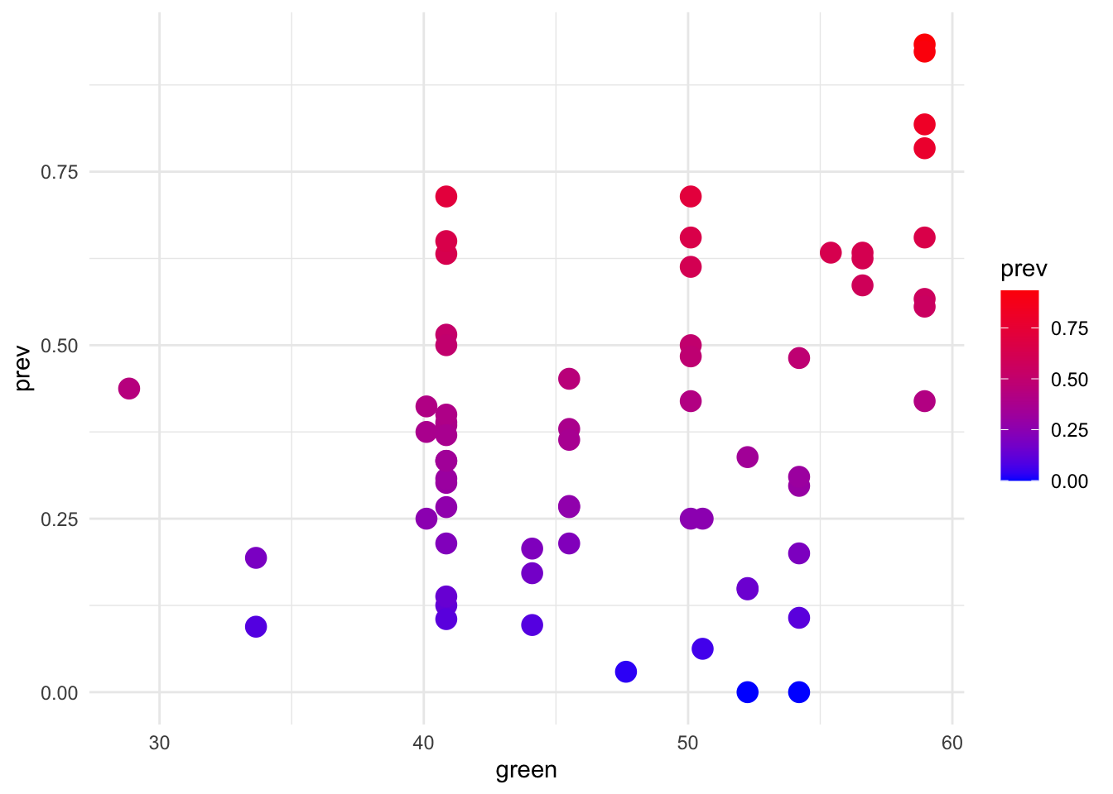
Malaria prevalence across villages
A scatterplot was created using the x and y coordinates in the Gambia dataset to see how the average presence of malaria or “prevalence” was seen in villages as we approach green-ness of vegetation

Slide 29
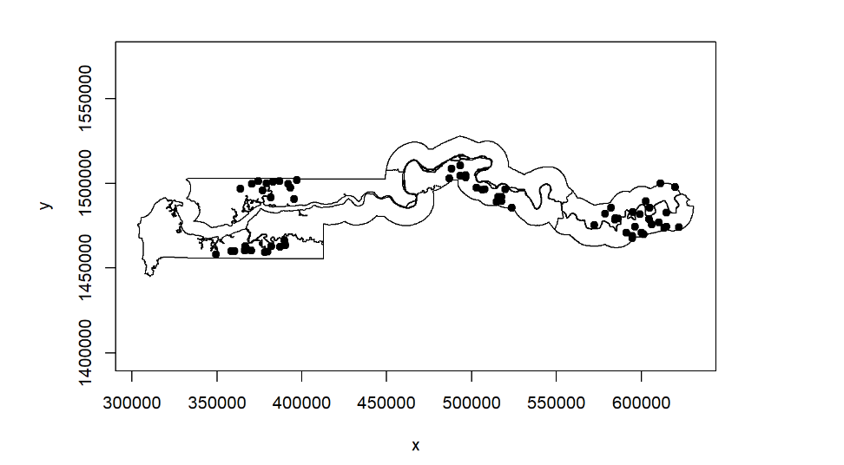
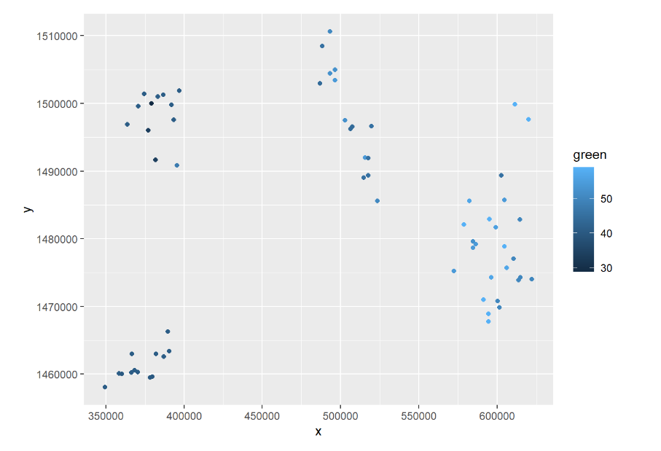
Malaria prevalence across villages
This areas can be seen with the graphs seen above. One shows the original plot of ‘gambia border’ map that is in R. The other shows that same x/y plane geographically with an added variable of ‘green.’ This being the proportionality higher areas with vegetative life. This can help quite a bit when attempting to predict malaria prevalence in a given area.

Slide 30
Issues and/or limitations
The Gambia Malaria dataset significant variables were only 3
Therefore, parameter tuning proved challenging using Bayesian modeling
Despite trying different combinations of parameters for Beta, lambda, and tau, there was little to no significant impact on any of the models’ performance
The implementation of an interaction term was attempted but could not be studied due to unresolved errors. These would combine variables netuse and treated. Identifying whether the bed-nets were treated or not, we believe, would have provided us with clearer insights to the effectiveness of treated bed-nets in preventing Malaria
Improvement in science and Medicine since this data was collected requires the need for updated variables for more accurate future modeling

Slide 31
Summary
The Bayesian ridge logistic regression performed the best in terms of the 5-fold CV AUC, but the Bayesian SSVS is preferred by the Bayes Factor.
For DIC, Bayesian SSVS performed best and for WAIC Bayesian Lasso logistic regression performed best
The determination of best model would be at the user's discretion; different models performed better on varying criteria. Overall, SSVS met the most criteria and allowed us to navigate. our data seamlessly. Our most significant variables were age, netuse and green. The analysis shows promising results especially in SSVS. age and green exhibited positive correlations while netuse displayed negative correlations as pos increased.
As the age of children increase in days, the presence of Malaria in their blood sample also increases
As the measure of green-ness in villages vicinity increases, the presence in their blood sample increases
As the use of a bed-net increases, the presence of Malaria in their blood sample decreases.

